Slide 1
Major Incidents: The Approach at the Scene
Zoë Hayman
Senior Lecturer, Department of Paramedics
MIMMS Course Director & Instructor, HMIMMS Instructor
MSc – Medical and Healthcare Simulation
Notes:
Generic principles, some parts you may struggle with ethically but courses such as the MIMMS course are designed to cross military & civilian and other countries

Slide 2
What is a Major Incident?
An incident where the number, severity, or type of live casualties, or by its location, requires extraordinary resources
An incident that presents a serious threat to the health of the community
An incident that disrupts the health service
(Major Incident Medical Management & Support Course, ALSG, 2014
Notes:
Number of casualties alone does not determine a major incident for the health service, e.g. 30 walking wounded fine for one hospital but 30 severely injured would need extraordinary resources.
ITU beds/ burns beds may be scarce/ regional
A remote major incident requires greater resources to get to casualties

Slide 3
NHS Major Incident Definition
“Any occurrence that presents serious threat to the health of the community, disruption to the service or causes (or is likely to cause) such numbers or types of casualties as to require special arrangements to be implemented by hospitals, ambulance trusts or primary care organisations”

Slide 4
Major Incident – Four Stages
The initial response
The consolidation phase
The recovery phase
Restoration of normality
Notes:
Initial Response – the incident has occurred and emergency services personnel are arriving on scene
Consolidation phase – dealing with the incident and getting the casualties to definitive care
Recovery phase – may last days or weeks within secondary healthcare system; may last years in the community (inquest, legal proceedings, anniversaries)
Restoration of normality – re-booking cancelled surgeries, outpatient appointments, replenishment of equipment etc – big cost implications for Trusts.

Slide 5
The Structured Response - CSCATTT
Command and control
Safety
Communication
Assessment
Triage
Treatment
Transport
Notes:
General principles
CSCA – management part of the plan
TTT – represents the medical response that is required

Slide 6
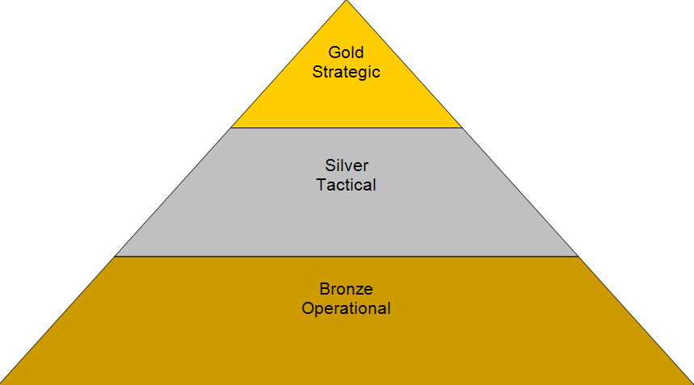
Command & Control
The cornerstones of major incident management
Requires good communication between and among all of the services
Movement in and around the incident is controlled by the police or by the fire service if there are hazards present
Gold (strategic), Silver (tactical), Bronze (operational)
Notes:
Gold – based in a central ‘control’
Silver – at the scene but outside of the cordon – police, fire, ambulance, medical together
Bronze – at the scene inside the cordon

Slide 7
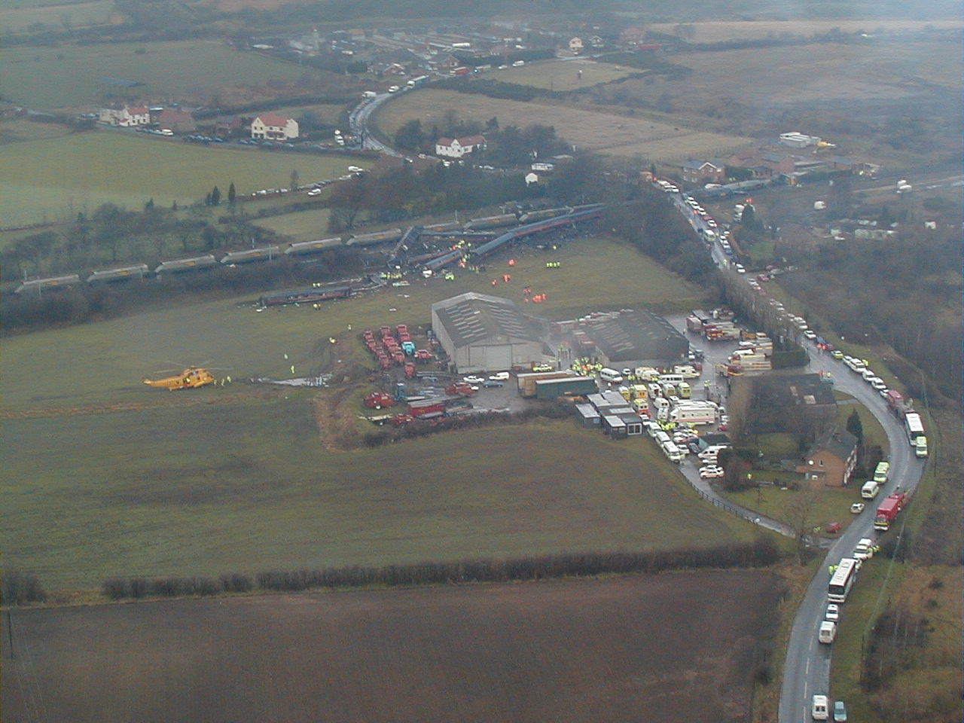
Notes:
Almost the ‘perfect’ major incident site.
Incident is Selby train crash, Yorkshire UK, 28 Feb 2001. 10 dead and 70 injured. This equates to inner/outer cordon and illustrates tiers of command.
Describe an overview of the scene, highlighting the extent of the area. Go on to discuss ‘silver’ control.

Slide 8
Safety 1-2-3
Self
Scene
Survivors
Notes:
Self – PPE
Scene – police responsible, a potential crime scene. Need to preserve evidence.

Slide 9
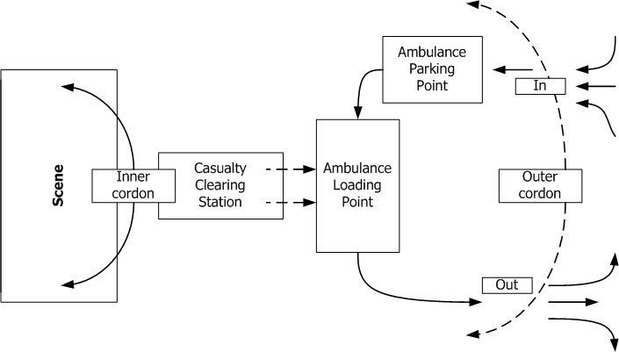
©ALSG, 2012
Notes:
Inner cordon controlled by the fire service generally. May depend on the event (airport exercise, police had command)

Slide 10
Communication
There are often issues with communications
Poor communication is the most common failing in a major incident

Slide 11
Methods of Communication
Mobile phone
Landline – most useful in hospitals. Messages should be passed through ambulance control where they can be recorded
Runners
Radio
Notes:
Mobile phone – voice procedure not necessary, not dependent on radio net, direct communication with hospital, nationwide & international coverage BUT lack of co-ordination, not recorded, limited cell may be swamped by all the calls. ACCOLC procedure – access overload control
Runners – reliable, quick, handwritten messages

Slide 12
Combined Emergency Service Response
Save life
Prevent escalation of the incident
Relieve suffering
Protect the environment
Protect property
Rapidly restore normality
Facilitate enquiries

Slide 13
Ambulance Service at the Scene
First Crew
Command: acting ambulance commander
Safety: 1-2-3
Communication: ‘METHANE’
Assessment
Do not attempt treatment or rescue of casualties
Driver to stay with the vehicle (until instructed by a senior ambulance officer)
Notes:
METHANE – the quality of the first information that is passed from the scene is important in determining the speed and adequacy of the subsequent response

Slide 14
METHANE
Major incident STANDBY or DECLARED
Exact location
Type of incident
Hazards – actual and potential
Access and egress
Number and severity of casualties
Emergency services, present & required
Notes:
Exact location – Grid reference
Type – rail, chemical, road
Access – direction of approach but also getting to the casualties (Clapham – steps dug into bank to get down to casualties)
Number – include type in this

Slide 15
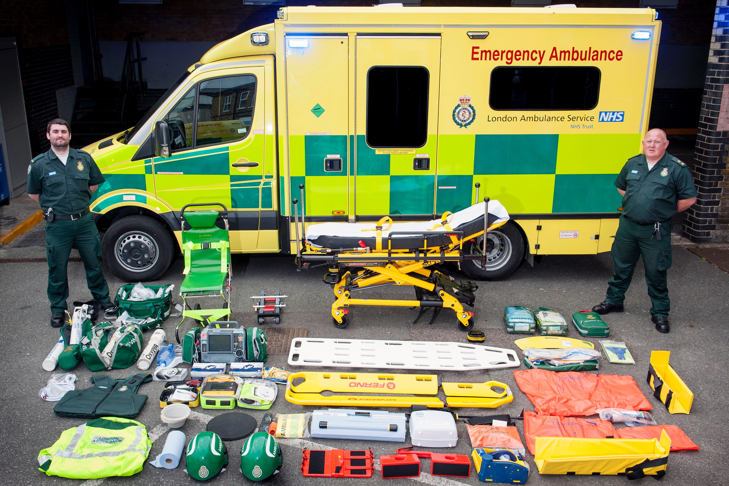
Predetermined Attendance
As a result of the London Bombings in 2005, London Ambulance Service and South East Coast Ambulance Service now send a predetermined response to a major incident
For LAS, this is 20 ambulances, 10 officers and all available emergency support vehicles carrying extra equipment
Notes:
We have looked briefly at the management part of the plan, we now need to look at the medical response.

Slide 16
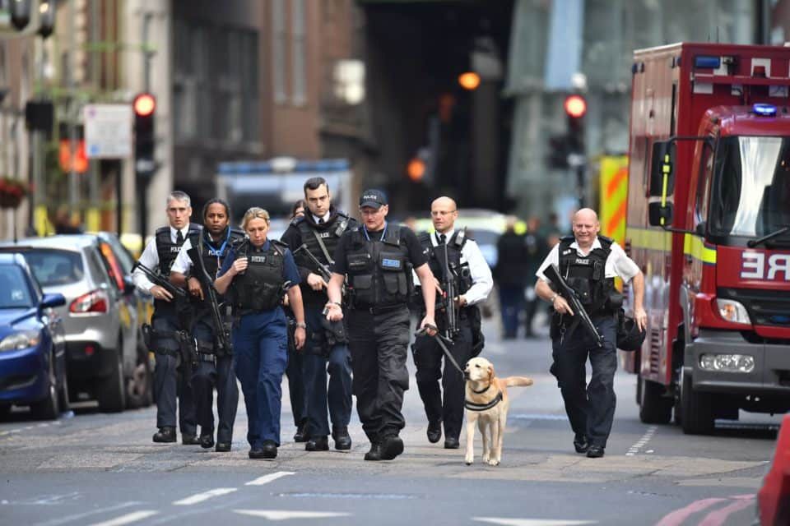
Police at the Scene
Command and Control
Provide traffic and cordon control
Establish forward (BRONZE) control
Overall incident (SILVER) control
Facilitation of other services
Public order and protection of property
Safety
1-2-3
Evacuation of uninjured survivors
Prevention of escalation

Slide 17
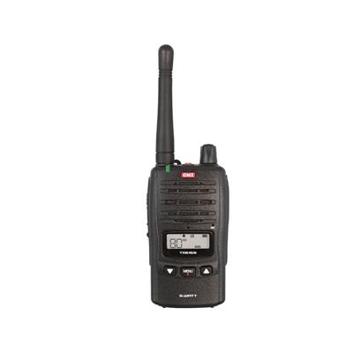
Police at the Scene
Communications
Liaison with other emergency services
Activation of support services
Media relations
Maintain record of uninjured survivors
Assessment
Assess for hazards
Assess for further police resources
Assess need to involve other emergency services
Identify the dead

Slide 18
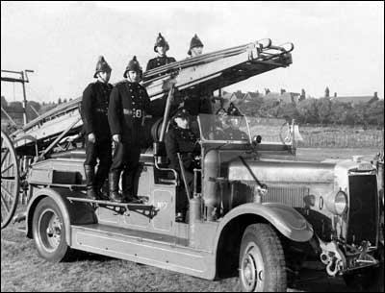
Fire Brigade at the Scene
Predetermined attendance – ensures an initial response and the presence of an appropriate senior officer
Notes:
Previous risk assessment will determine how many appliances are required and what officer will attend.
e.g. single appliance within 20 minutes appropriate in a rural area, city centre fire – 2 appliances on scene within 5 minutes with 3rd appliance arriving no more than 3 minutes later

Slide 19
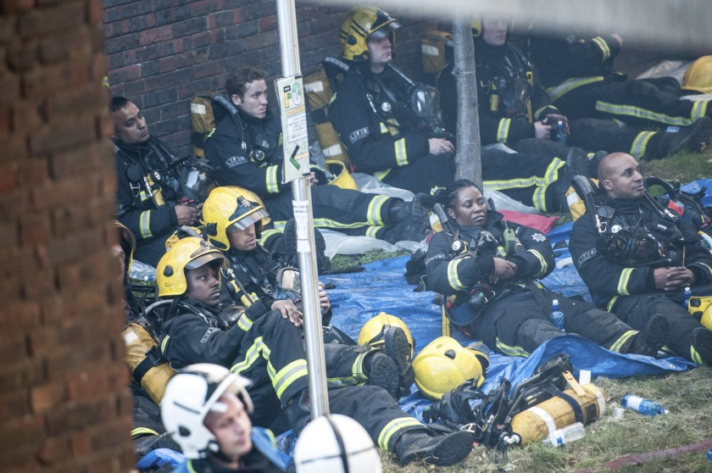
Fire Brigade at the Scene
Assessment
Continual scene hazard assessment
Provide specialist equipment
Triage
Treatment
Life-saving treatment
Free the dead
Transport
Assist in extrication
Assist with carrying casualties
Clear routes in and out

Slide 20
Triage
Triage Sieve (quickly assigns priorities)
At the scene
Dynamic
Triage Sort (refines the priorities)
More detailed
At the Casualty Clearing Station
Dynamic – patient’s status may change
Notes:
Suzan covering this in more detail.

Slide 21
Treatment
Aims
To allow the maximum number of casualties to reach the hospital safely “do the most for the most”
Most treatment at the site of a major incident will be directed towards the support of ABC’s
Levels of Treatment
Life-saving first aid
Advanced life support
Specialist
Packaging for transport
Notes:
Will be carried out at the scene, the casualty clearing station and the hospital
Paramedic (TRU), medics, nurses

Slide 22
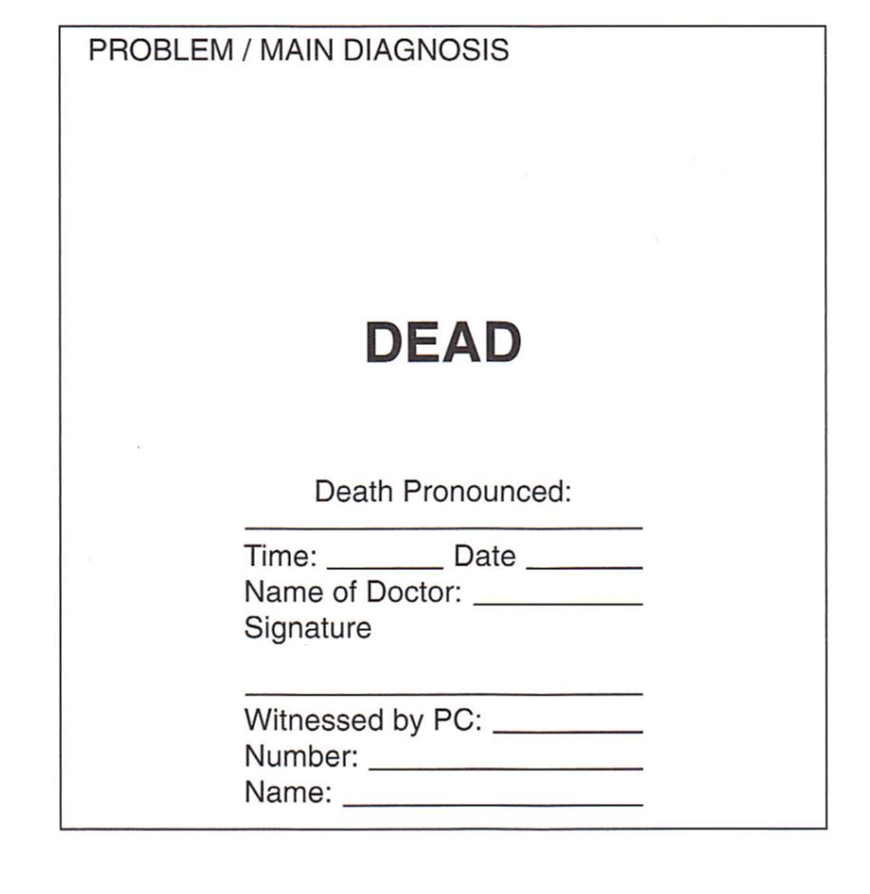
Management of the Dead
Declaration – by an authorised person, in the presence of the police and adequately labelled
Movement – remember the need to protect forensic evidence
Identification- police responsibility; protect personal effects
Body holding area/temporary mortuary
Notes:
Places that have been used for temporary mortuary’s include sports hall, aircraft hangers (Staines aircrash 1975), refridgerator lorries
Bags mixed up have led to incorrect identification – should be left at the scene

Slide 23
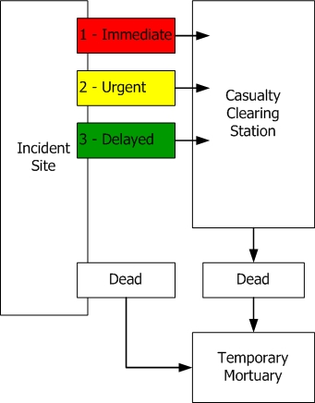
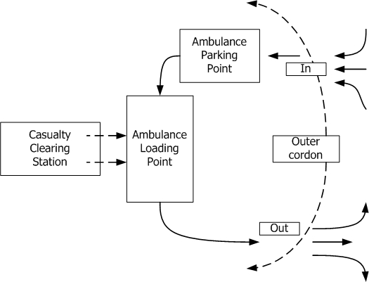
Transport
Casualty Flow
Vehicle Flow

Slide 24
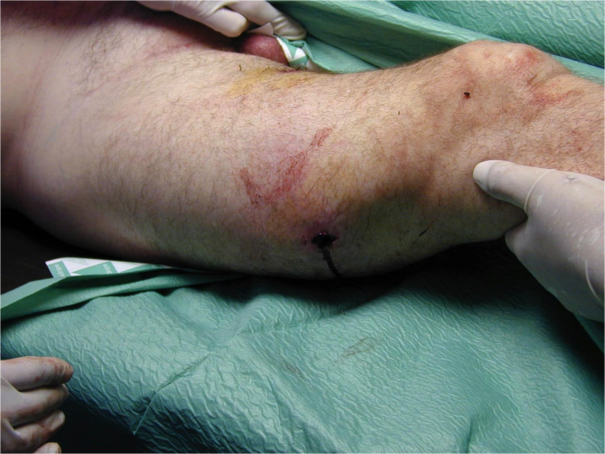
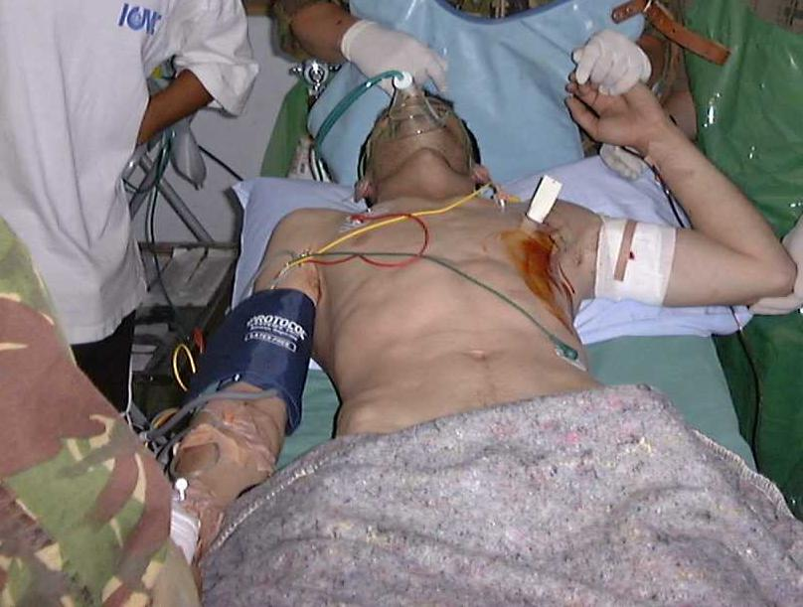
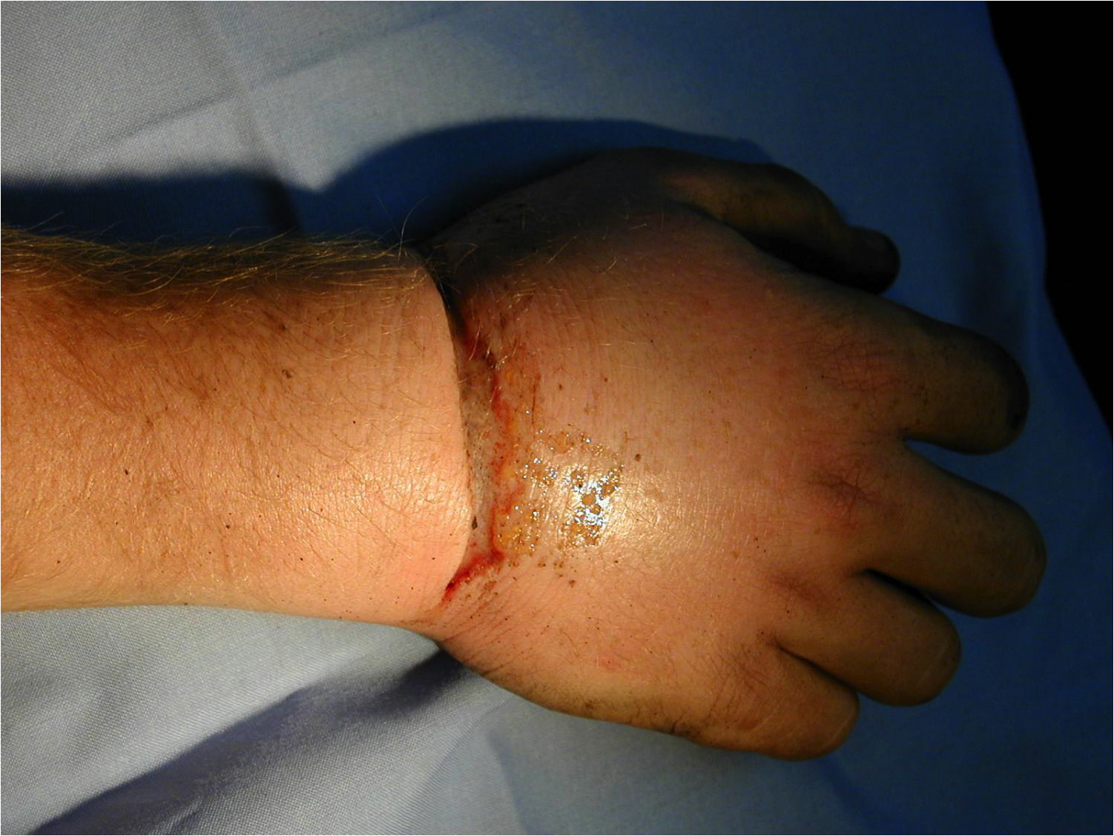
What Transport?
Urgent
Immediate
Delayed

Slide 25
What can go wrong?
Communications
Shortage of medical supplies
Failure to deal with survivors
Delays with some emergency services arriving on scene
Media
‘If you fail to plan, you are planning to fail’
(Benjamin Franklin)
Notes:
7/7 – Communications were poor, amb radio’s didn’t work underground, mobile network overloaded
Shortage of supplies – lack of stretchers, basic equipment such as bandages ran out
Failure to deal with survivors – hundreds of people walked away with no details taken - unlikely to have been offered trauma counselling
Roads closed/ busy so LAS couldn’t get to receiving hospitals
Manchester Arena bombing – Greater Manchester Fire & Rescue Service took two hours respond when it would normally be 6 minutes – combination of poor communication and poor procedures (Kerslake Report 2018)
Media – intrusive following Manchester arena bomb - they also have an important and positive role to play

Slide 26
Any Questions?

Slide 27
Summary
Command and control
Safety
Communication
Assessment
Triage
Treatment
Transport

