Slide 1
The Implementation of the Professional Nurse Advocate role in Critical Care
A Service Evaluation
Lucy Corn
Professional Nurse Advocate
Amy Stallard
Professional Nurse Advocate
Jacqueline Gaynor
Professional Nurse Advocate

Slide 2
PNA Service in Critical Care
The Reach
7 Units (2 sites) approx 105 beds
Approx 570 staff bands 2 - 7
2021 - 2023 - 13 critical care nurses trained PNAs
2024 - 4 critical care nurses recently completed PNA training

Slide 3
Implementing the role
Two approches
Building awareness
Assessing engagement

Slide 4
Building awareness
New Starter Training days and Introduction to Critical Care Course (ICCC) ​
ICCC RCS sessions (Online) ​
Emails​
Booking system ​
'Who are we’ Poster ​
Mandatory Training​
Information cards​
Social events

Slide 5
Establishing the PNA team
Group email​
Meetings with HoN and lead PNA ​
Rota introduction including a launch day
MS teams channel ​
Supporting and supervising new PNAs​
Shared spreadsheet to track activity

Slide 6
Assessing engagement
Recording PNA activity
Feedback Survey post PNA activity

Slide 7
1. Recording PNA Activity
Data collection
A shared spreadsheet, easily accessible by all PNA’s on dedicated MS Teams channel. Included data sets required by NHS England for monthly reporting plus others specific to the trust.

Slide 9
2. Feedback Survey
Gain insight into the value of the service
A short electronic survey created and collected on MS Forms, sent to those who accessed the service. Completed annoymously

Slide 10
Survey Results
100%
86%
100%
of those surveyed either felt the session met or exceeded their expectations
would Attend another session
would recommend the service

Slide 11
“The PNA was very professional in their approach, took time to listen and really understood my concerns. They skillfully guided the conversation to ensure all my concerns were addressed. We also discussed career opportunities and there was time to look through current job roles advertised within the trust that might suit my preferences-this exceeded my expectations.”
“I am extremely grateful for the restorative clinical session by a PNA, that I attended last year, which was both validating and extremely useful in helping me to have the courage to push forward in my career and do what was best for my mental wellbeing.”

Slide 12
Evaluating the PNA service
Year on year review comparing awareness aganist enegagement
2021
2022
2023
2024

Slide 13
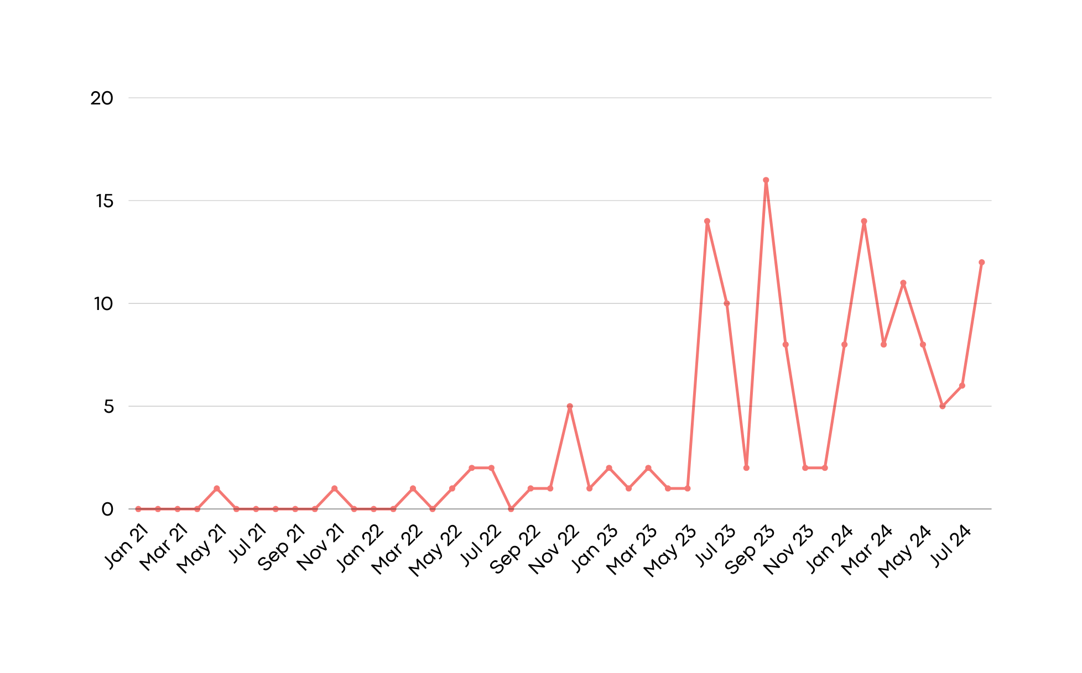
Awareness and engagement
PNA Rota
Introduction to PNA on Mandatory Training Day
Number of PNA conversations
Booking System
Introduction to PNA on New Starter Training

Slide 14
Key points
A total of 149 PNA conversations have taken place | Approx. 550 staff have attended an awareness session | Year on year PNA engagement has increased | Conversation themes included: stress, anxiety, career advice, well-being and debriefing | A structured rota for accessing the service shows an increase engagement

Slide 15
Challenges
 | How to measure success
 | Difficult conversations
 | Role division
 | Diversity and seniority in PNA team
 | How to engage PNAs themselves
 | Support and longevity

Slide 16
Summary
Awareness of the role and a structured rota has been shown to increase engagement
Feedback has demonstrated that staff value the PNA role
There are number of challenges to overcome
It would be beneficial to evaluate how the PNA role impacts retention rates and staff satisfaction levels

Slide 17
“The PNA service in its simplicity offers staff the chance to use a sounding board, safe in the knowledge that their challenges can stay confidentially in that room and they can say whatever they need to without fear of reprimand or action. It has been encouraging to see so many colleagues using the sessions go on to consider that they too would like to become PNAs as the service has had such value in their experience. Nursing continues to be a challenging career choice, especially in critical care and support should be available to those giving so much to others.”
“Thank you so much for running this service. It's much appreciated by those who use it.”

Slide 18
Thank you

Slide 19
References
Dall’Ora, C., Ball, J., Reinius, M. and Griffin, P. (2020) Burnout in nursing: a theoretical review. Human Resources for Health 18(41) Available from: https://doi.org/10.1186/s12960-020-00469-9
NHS England. (2021) Professional Nurse Advocate A-EQUIP model: a model of clinical supervision for nurses. Available from: https://www.england.nhs.uk/nursingmidwifery/delivering-the-nhsltp/professional-nurse-advocate/

